Slide 1
PS- Innovative Monitoring System for TeleICU Patients Using Video Processing and Deep Learning.
By- Roanek Jena

Slide 2
Problem Statement
PS-7: -
Innovative Monitoring System for TeleICU Patients Using Video Processing and Deep Learning.
AIM:
The aim of this problem statement was to develop a TeleICU model using deep learning approaches which can give insight on the things happening in ICU.
The data acquired through this method would be analysed and necessary action can be taken the person in-charge.
DATASET AQUISITION:
The dataset for training of various models have been acquired through these sources:
- Google images, Shutterstock, Roboflow Universe, Kaggle.

Slide 3
Unique Idea Brief (Solution)
The ideas I have used for each functionality are as follows:
Intensivity detection:
- Use of yolov8s (small) model, so as to get fast processing speed.
- Trained on custom dataset.
Chest Pain detection:
Use of yolov8n (nano) model, so as to get faster processing speed. As this will be a subprocess.
Trained on custom dataset.
Fall detection:(Trained on custom dataset)
For this detection a posenet2.0 model is used here.
Posenet is known for their fast inferencing speed.
As a person falling is a fast action, this model was choosen.

Slide 4
Unique Idea Brief (Solution)
Vital-Sign detection:
Use of dual model system both trained on yolov8n for faster processing.
The first model detects the monitors in the image, then the second model extracts the vital information from the monitor by taking out the roi(Region of Interest) and scanning it.
Then the information(mainly HR is monitored) is published.
Trained on custom dataset.

Slide 5
Features Offered
Intensivity Detection Model: YOLOv8 (best.pt)
Functionality: This model is designed to detect individuals within an ICU setting, distinguishing between different categories such as intensities, family members, and patients. By processing video frames with an input shape of (1, 3, 640, 640), the model helps in identifying and tracking the presence of these entities in real-time. This is crucial for monitoring the ICU environment and ensuring that only authorized personnel are present.
Chest Pain Detection Model: YOLO Nano-S (best_chest.pt)
Functionality: This model scans every 3rd frame of the video feed to detect signs of chest pain in patients. If the model identifies a chest pain indication within a patient bounding box for a continuous duration of 3 seconds, it triggers an alert. The input shape for this model is (1, 3, 416, 416). This feature is essential for promptly responding to critical conditions and providing immediate medical attention.

Slide 6
Features Offered
Vital Signs Detection Models: (Experimental)
YOLOv8 for Monitor Detection (best_monitor.pt)
YOLOv8 for Vitals Detection (best_vitals-2.pt)
Functionality: This dual-model setup is designed to monitor the patient's vital signs. The monitor detection model identifies the monitor within the frame, while the vitals detection model focuses on the vital sign readings displayed on the monitor. Both models process every 3rd frame with an input shape of (1, 3, 416, 416). Using EasyOCR, the system reads the heart rate (HR) from the bounding box. If the HR value is below 60 or above 155, an alert is triggered, indicating potential medical issues that require attention. This feature ensures continuous and accurate monitoring of vital signs, crucial for patient health management.

Slide 7
Features Offered
Fall DetectionModel: PoseNet 2.0 (fall.tflite)
Functionality: The fall detection model uses PoseNet 2.0 to analyze every 3rd frame for any indications of a fall. By monitoring the patient's posture and movements, it can accurately detect falls and subsequently trigger alerts to ensure quick response times. This feature is vital for preventing injuries and ensuring patient safety.

Slide 8
Process flow
INPUT FEED
Fall Detection
No Intensivity
INTENSIVITY DETECTION
Chest Pain Detection
OUTPUT FEED
/ALERT
Processed Feed
Check for Intensivity Again
Vital Sign Detection
Action

Slide 9
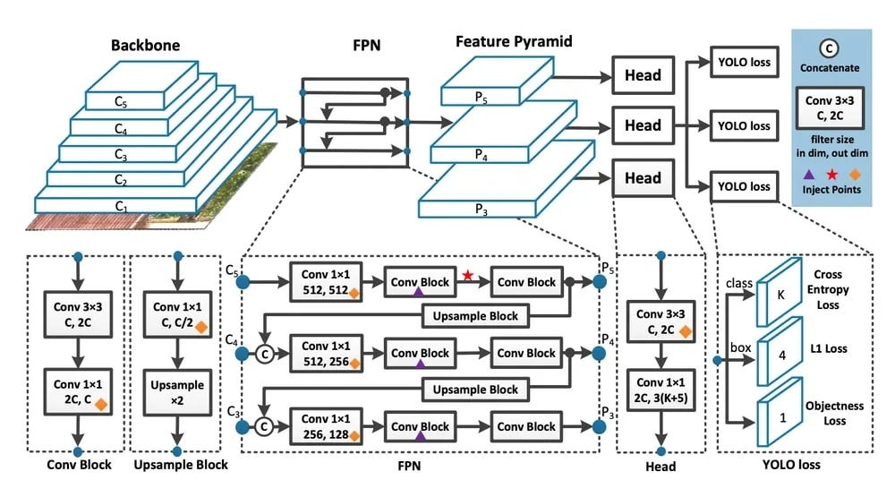
Architecture Diagram
YOLOv8 is built on cutting-edge advancements in deep learning and computer vision, offering unparalleled performance in terms of speed and accuracy. Its streamlined design makes it suitable for various applications and easily adaptable to different hardware platforms:
YOLOv8s (Small)
Backbone: CSPDarknet
Consists of a series of convolutional layers with CSP (Cross Stage Partial) connections that enhance feature propagation and learning capabilities.
Typically, the backbone includes layers such as Conv, CSP, and SPP (Spatial Pyramid Pooling).

Slide 10
Architecture Diagram
Neck: PANet (Path Aggregation Network)
Combines features from different layers to better fuse the low-level and high-level feature information.
Includes layers such as FPN (Feature Pyramid Network) and PAN (Path Aggregation Network).
Head: YOLO Head
Outputs the final detection results with bounding box coordinates, objectness scores, and class probabilities.
Uses convolutional layers to predict bounding boxes at multiple scales.

Slide 11
Architecture Diagram
YOLOv8n (Nano)
Backbone: CSPDarknet-Tiny
Similar to the small variant but with a significantly reduced number of layers and parameters.
Focuses on lightweight and fast processing suitable for edge devices.
Neck: PANet-Tiny
A more simplified version of the PANet used in YOLOv8s.
Ensures efficient feature fusion with reduced complexity.
Head: YOLO Head
Similar to the small variant but optimized for faster inference with fewer parameters.
Outputs detection results with reduced computational requirements.

Slide 12
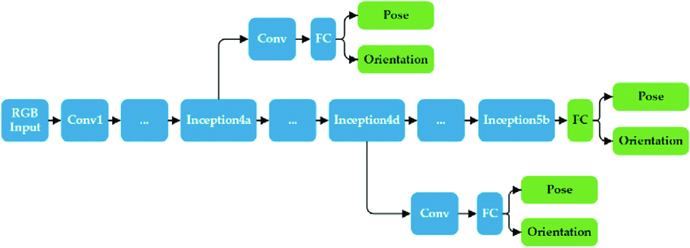
Architecture Diagram
PoseNet 2.0
Here's a general overview of the architecture:
Backbone
Feature Extractor: MobileNetV2 or ResNet
A convolutional neural network (CNN) used to extract features from the input image.
MobileNetV2 is often used for its efficiency and speed, especially in real-time applications.
ResNet can be used for more accurate keypoint detection but with a higher computational cost.
Pose Estimation Head
Keypoint Detection:
The head consists of several convolutional layers designed to output heatmaps.
Each heatmap corresponds to a specific keypoint (e.g., nose, eyes, elbows, etc.).
Offset Regression:
In addition to heatmaps, the model predicts offset maps to refine the keypoint locations.
This helps in achieving higher accuracy by adjusting the positions predicted by the heatmaps.

Slide 13
Technologies Used
YOLO MODEL: (uses Ultralytics, Pytorch)
YOLO (You Only Look Once) is a series of object detection models known for their speed and accuracy. YOLOv8 is a continuation of this series, building on the strengths of its predecessors while introducing new advancements in efficiency, architecture, and performance.
Key Features of YOLOv8
Improved Backbone Network:
Enhanced Neck and Head:
Architectural Variants:
YOLOv8s (Small):
YOLOv8n (Nano): Optimized for Real-Time Applications:
Advanced Training Techniques:
Compatibility and Deployment:

Slide 14
Technologies Used
PoseNet2.0: (uses Tensorflow)
PoseNet is a deep learning model designed for real-time human pose estimation. It detects and locates keypoints on the human body, such as joints (e.g., shoulders, elbows, wrists, hips, knees, and ankles), to understand the person's pose and movements. PoseNet can work on single images or video streams, making it suitable for applications in fitness, gaming, augmented reality, and surveillance.
Key Features of PoseNet
Keypoint Detection:
Real-Time Performance:
Lightweight Architecture:
Numpy: For Arranging tensors.
OpenCV: For video processing.
Time & Collections: For frame manipulation.
EasyOCR: For vital sign detection.

Slide 15
Team members and contribution:
Dataset Acquisition: Roanek Jena
Functionality Creation: Roanek Jena
Idea submission: Roanek Jena
GitHub repo creation: Roanek Jena

Slide 16
Conclusion
In conclusion, the development of an innovative monitoring system based on video processing and deep learning technologies for TeleICU patients represents a significant step in the care and monitoring of patients. The new system has various advantages, which include but not limited to the immediacy of crucial event notification, all-time tracking of patient vitals as well as rapid identification of accidents like falling. Using cutting-edge models such as YOLOv8 for object detection.
The integration of video processing with deep learning enables the extraction of valuable insights from visual data, facilitating proactive interventions and timely medical responses.
This not only enhances patient safety and outcomes but also optimizes the workload of healthcare professionals, allowing them to focus on providing personalized care.
Overall, the use of the recent technology in treating ailment makes it evident that TeleICU area can attain quality patient monitoring if such technology is put in place. This implies that in the future, more can be done than mere caring for the sick individuals in remote places or ensuring that those suffering from severe illnesses live healthily.

Slide 17
THANK YOU

